Slide 1
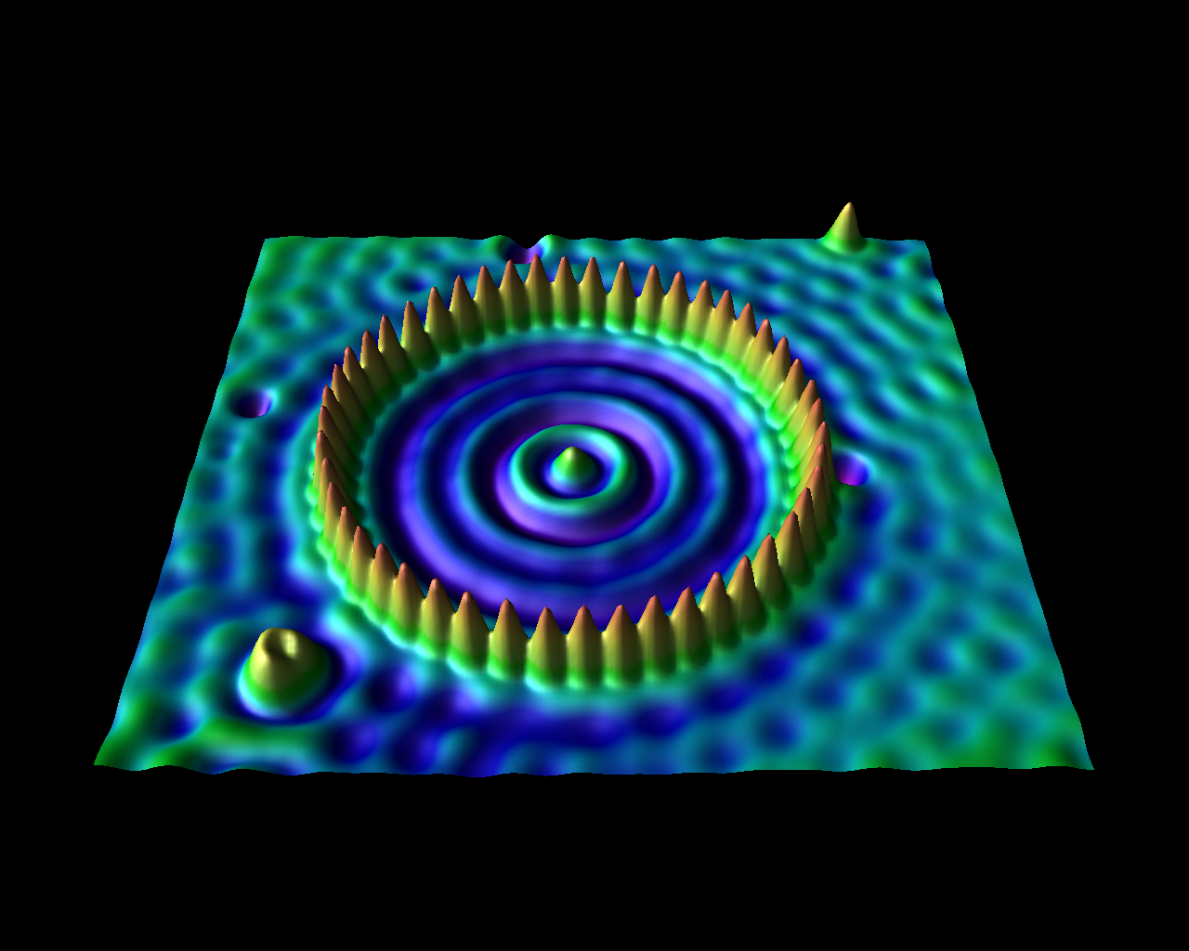
Physics 3330
Electronics for the Physical Sciences
Heather Lewandowski Tuesday Lab 9:00 – 11:50 am
Kyle McElroy Tuesday Lab 2:00 – 4:50 pm
Kevin Stenson Thursday Lab 9:00 – 11:50 am new section
Dimtry Reznik Thursday Lab 2:00 – 4:50 pm
John Price Lectures 1:00 – 1:50 Tuesday and Thursday

Slide 2
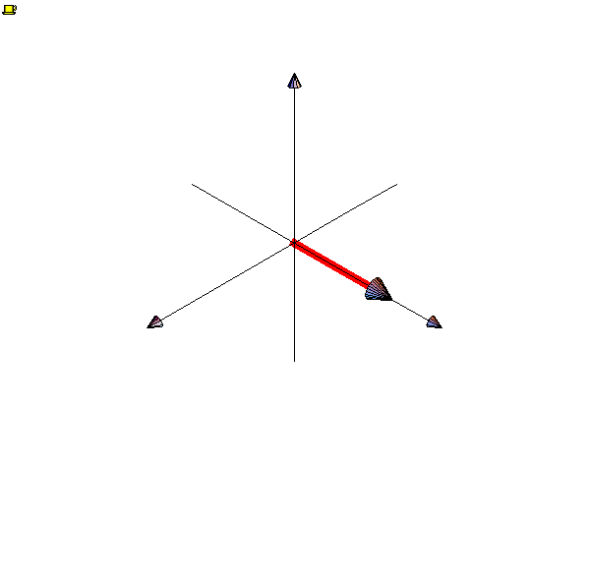
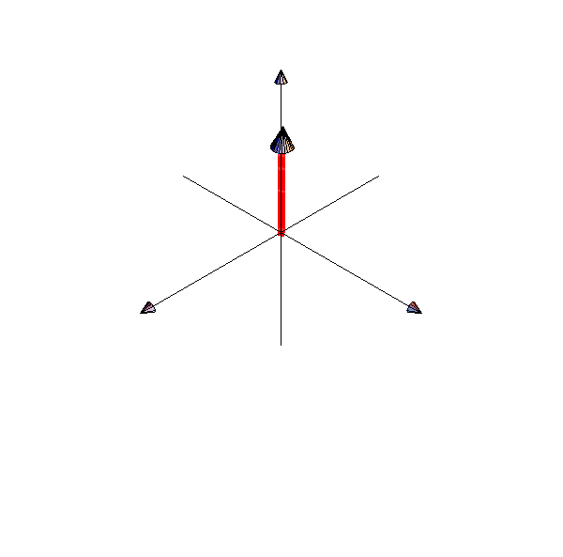
Liquid-phase proton FT-NMR spectroscopy
Coil
Transmit
Notes:
To make an NMR signal you put a coil of wire near the aligned protons.
*click*
By sending a brief radio-frequency pulse into the coil to can create a varying magnetic field that has the effect of tipping the protons over so they are now perpendicular to the magnetic field. This is called a 90-degree pulse and this part of NMR is called the transmit phase. The magnetic field will try to realign the proton...
Transition to the next slide is required here to make the GIF animations start at the right moment. Do not separate these two slides.

Slide 3
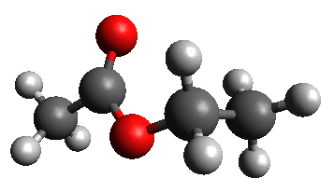
Liquid-phase proton FT-NMR spectroscopy
Coil
frequency
Receive
NMR Spectrum
Notes:
…but because the proton has spin, like a gyroscope, it will precess around the magnetic field direction before it realigns. The precession creates a time varying magnetic field through the coil, and this induces a voltage according to Faraday's law. The induced signal is called a free induction decay, or FID, and this is the receive phase of pulsed NMR. Its called FID because it is a free motion of the proton that induces a signal and quickly decays away.
*click*
The precession frequency depends on the strength of the magnetic field. Gen3MR designs will have precession (or Larmor) frequencies of 15 to 20 MHz. Higher frequencies give stronger signals but require larger and more expensive magnets.
*click*
We have already said that the proton will realign after T1 and that time is shown about right in this animation, but of course the precession rate has been drastically slowed down so you can see the motion. From this animation you might think that the FID signal would last a time T1, but that is not the case. There are really many many protons and they are not all in exactly the same magnetic field, so they dont precess at exactly the same rate. They get out of phase and the signal disappears after a time T2, which is about 100 microseconds for our technology.

Slide 4
A1
Do you have your clicker and know how to operate it?
A: Yes
B: No

Slide 5
A2
Who is responsible for your safety?
A: The US Government
B: The State of Colorado
C: The University of Colorado
D: The Physics Department
E: Yourself

Slide 6
A3
What is the most likely way a physicist will die at work?
A: Toxic chemicals
B: Explosions
C: Electrocution
D: Disgruntled graduate student

Slide 7
A4
What will kill you?
A: Current
B: Voltage
C: Power

Slide 8
Effects of Current (AC and DC)
10 to 20 mA painful sensation
20 to 40 mA muscular paralysis, cannot let go
40 to 80 mA breathing is difficult
100 to 200 mA fibrillation of the heart and death
> 200 mA heart muscles are clamped
Recovery is possible with immediate first aid.
Turn power is off before trying to help!

Slide 9
20 -200 mA can kill you!
You will work with 15 V max
Skin resistance with small contact area ~100 kΩ

Slide 10
A6
Is 15 V safe?
A: Yes
B: No

Slide 11
But, higher voltage and larger contact areas can be lethal.
Do not expose yourself to the 110V power line!

